Slide 1
Selective Perfumery study in Portugal
Estimation of 2020 market
Shopper Insights
May 2021

Slide 2
Conclusions
Market Estimation
Engagement with categories
Based on the consumers perception for the categories in study we estimate that Perfumery channel represents:
31% of the sales in volume and 47% in value
Perfumery groups are responsible for the majority of the business » about 26% in volume and 40% in value
Others perfumeries are responsible for about 5% in volume and 7% in value
Fragrances is the category where Perfumery channel has more weight either in volume (51%) as in value (69%)
Online sales already represent a significant part of the business, especially in Fragrances and Face Creams (more than 20% of sales)
Fragrances, Face Creams and Body moisturizing are the categories with higher penetration
Fragrances: 82% bough »» 2/3 in Perfumeries
Face Cream: 80% bough »» 31% in Perfumeries
Body moisturizing: 76% bough »» 23% in Perfumeries
Face Clean products: 62% bough »» 22% in Perfumeries
Body treatment creams: 36% bough »» 15% in Perfumeries
Lips makeup: 40% bough »» 19% in Perfumeries
Eyes makeup: 38% bough »» 13% in Perfumeries
Face makeup: 34% bough »» 15% in Perfumeries
Nails polish: 28% bough »» 13% in Perfumeries
Sunscreens: 74% bough »» 12% in Perfumeries
Hypermarket still the preferred channel to buy creams but Perfumery groups lead as local to buy makeup products
The main reason to not buy in Perfumeries is the perception of higher prices
Among Perfumery groups, Perfumes & Companhia, Boticário and Sephora are the preferred ones to buy.

Slide 3
Economic context

Slide 4
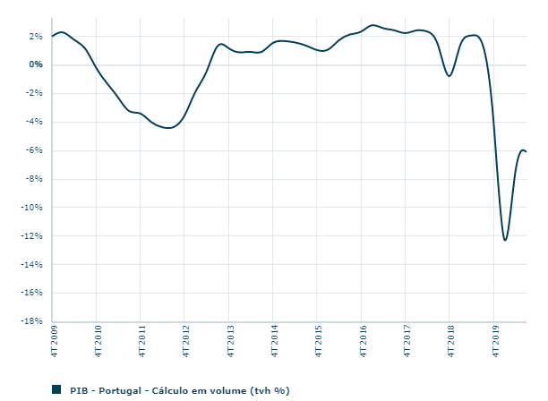
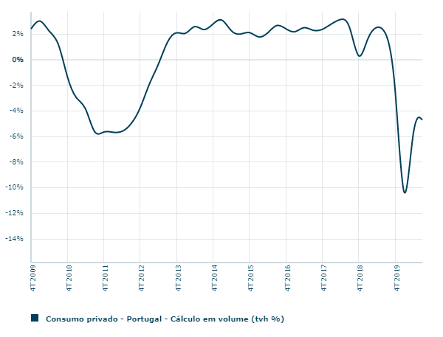
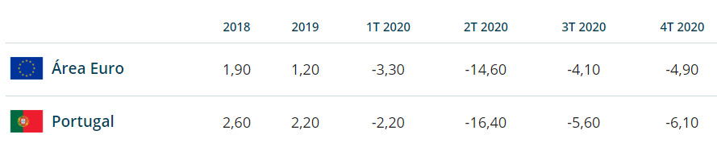
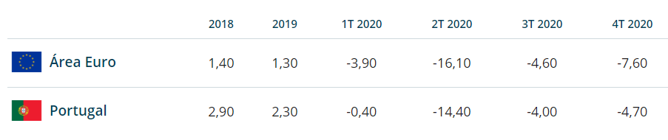
In 2020 with pandemic the private consumption decreased
PIB
Private Consumption
Fonte: Banco de Portugal, June 2021
Notes:
GDP almost aligned with Europe
Unemployment below Europe

Slide 5
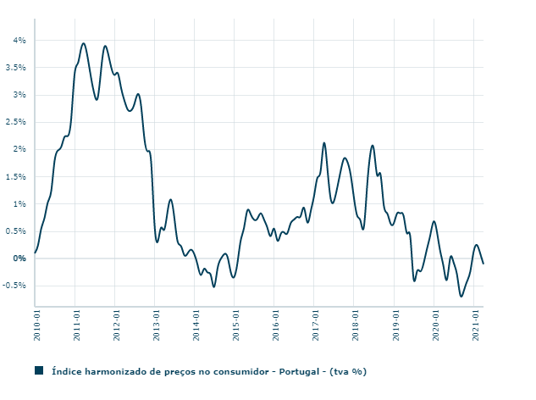
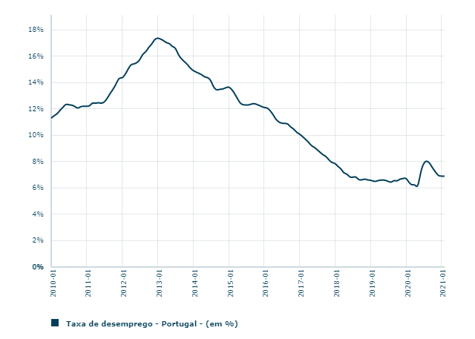
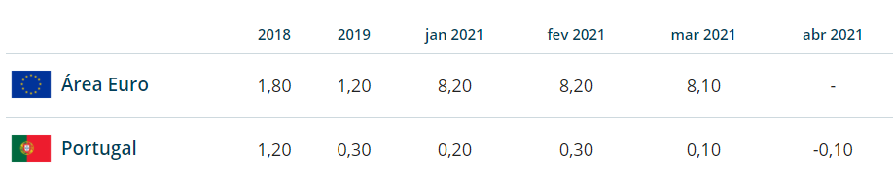

Despite that the impact on unemployment was not high
inflation
Unemployment
Fonte: Banco de Portugal, June 2021
Notes:
GDP almost aligned with Europe
Unemployment below Europe

Slide 6
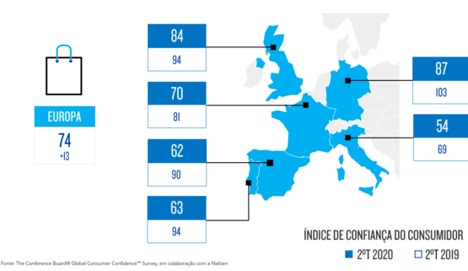
Pandemic and public health crisis with economic consequences impacted the consumer confidence all over the world Portugal was not an exception …

Slide 7
Market estimation

Slide 8
During 2020…
… Perfumery channel (groups and others) represented among categories in study
31% of the sales in volume
(26% perfumery groups + 5% other perfumeries)
47% of the sales in value
(40% perfumery groups + 7% other perfumeries)
Estimated sales in volume (total): 67 073 659 units
Estimated sales in value (total): 774 716 677 €
* Results estimation with base in a survey applied among consumers

Slide 9
Fragrances is the category where Perfumery channel has more weight either in volume as in value
Perfumery Channel weight (estimated)
 | Volume | Value
Fragrances | 51% | 69%
Face creams | 39% | 44%
Face Cleaning Products | 26% | 39%
Body moisturizing creams | 26% | 36%
Body Treatment creams | 20% | 48%
Lips makeup | 17% | 51%
Eyes makeup | 14% | 43%
Face makeup | 15% | 59%
Nails polish | 15% | 52%
Sunscreen | 10% | 30%
* Results estimation with base in a survey applied among consumers

Slide 10
Fragrances
Perfumery channel (groups and others) represented …
51% of the sales in volume
(40% perfumery groups + 11% other perfumeries)
(Offline » 30% + Online » 21%)
69% of the sales in value
(55% perfumery groups + 13% other perfumeries)
(Offline » 42% + Online » 26%)
Estimated sales in volume (total): 455 205 units
Estimated sales in value (total): 158 526 825 €
* Results estimation with base in a survey applied among consumers

Slide 11
Face Creams
Perfumery channel (groups and others) represented …
39% of the sales in volume
(32% perfumery groups + 8% other perfumeries)
(Offline » 20% + Online » 19%)
44% of the sales in value
(35% perfumery groups + 9% other perfumeries)
(Offline » 23% + Online » 21%)
Estimated sales in volume (total): 18 464 704 units
Estimated sales in value (total): 212 305 685 €
* Results estimation with base in a survey applied among consumers

Slide 12
Face Cleaning Products
Perfumery channel (groups and others) represented …
26% of the sales in volume
(22% perfumery groups + 4% other perfumeries)
(Offline » 16% + Online » 10%)
39% of the sales in value
(34% perfumery groups + 6% other perfumeries)
(Offline » 25% + Online » 14%)
Estimated sales in volume (total): 6 732 441 units
Estimated sales in value (total): 39 762 035 €
* Results estimation with base in a survey applied among consumers

Slide 13
Body Moisturizing Creams
Perfumery channel (groups and others) represented …
26% of the sales in volume
(22% perfumery groups + 4% other perfumeries)
(Offline » 15% + Online » 10%)
36% of the sales in value
(30% perfumery groups + 5% other perfumeries)
(Offline » 22% + Online » 13%)
Estimated sales in volume (total): 17 291 348 units
Estimated sales in value (total): 100 597 402 €
* Results estimation with base in a survey applied among consumers

Slide 14
Body Treatment Creams
Perfumery channel (groups and others) represented …
20% of the sales in volume
(19% perfumery groups + 1% other perfumeries)
(Offline » 13% + Online » 9%)
48% of the sales in value
(44% perfumery groups + 3% other perfumeries)
(Offline » 31% + Online » 17%)
Estimated sales in volume (total): 373 608 units
Estimated sales in value (total): 2 692 813 €
* Results estimation with base in a survey applied among consumers

Slide 15
Lips Makeup
Perfumery channel (groups and others) represented …
17% of the sales in volume
(15% perfumery groups + 2% other perfumeries)
(Offline » 12% + Online » 6%)
51% of the sales in value
(41% perfumery groups + 10% other perfumeries)
(Offline » 35% + Online » 16%)
Estimated sales in volume (total): 1 648 686 units
Estimated sales in value (total): 9 152 894 €
* Results estimation with base in a survey applied among consumers

Slide 16
Eyes Makeup
Perfumery channel (groups and others) represented …
14% of the sales in volume
(13% perfumery groups + 2% other perfumeries)
(Offline » 11% + Online » 4%)
43% of the sales in value
(39% perfumery groups + 4% other perfumeries)
(Offline » 32% + Online » 11%)
Estimated sales in volume (total): 5 083 308 units
Estimated sales in value (total): 30 139 862€
* Results estimation with base in a survey applied among consumers

Slide 17
Face Makeup
Perfumery channel (groups and others) represented …
15% of the sales in volume
(13% perfumery groups + 2% other perfumeries)
(Offline » 9% + Online » 6%)
59% of the sales in value
(55% perfumery groups + 4% other perfumeries)
(Offline » 34% + Online » 25%)
Estimated sales in volume (total): 5 702 386 units
Estimated sales in value (total): 89 203 329€
* Results estimation with base in a survey applied among consumers

Slide 18
Sunscreens
Perfumery channel (groups and others) represented …
10% of the sales in volume
(9% perfumery groups + 1% other perfumeries)
(Offline » 6% + Online » 4%)
30% of the sales in value
(29% perfumery groups + 1% other perfumeries)
(Offline » 13% + Online » 17%)
Estimated sales in volume (total): 8 205 229 units
Estimated sales in value (total): 120 831 937€
* Results estimation with base in a survey applied among consumers

Slide 19
Nails Polish
Perfumery channel (groups and others) represented …
15% of the sales in volume
(13% perfumery groups + 2% other perfumeries)
(Offline » 10% + Online » 15%)
52% of the sales in value
(46% perfumery groups + 7% other perfumeries)
(Offline » 34% + Online » 18%)
Estimated sales in volume (total): 3 116 744 units
Estimated sales in value (total): 11 503 896€
* Results estimation with base in a survey applied among consumers

Slide 20
Channels weight (estimation for Volume)
 | Fragrances | Face creams | Face Cleaning Products | Body moisturizing creams | Body Treatment creams | Lips makeup | Eyes makeup | Face makeup | Nails polish | Sunscreen
Perfumery groups -physical store | 26% | 17% | 14% | 14% | 13% | 11% | 9% | 7% | 9% | 6%
Perfumery groups -online | 14% | 14% | 8% | 9% | 6% | 4% | 3% | 5% | 4% | 3%
Perfumery others - physical store | 4% | 3% | 2% | 2% | 1% | 1% | 1% | 1% | 1% | 0%
Perfumery others -online | 7% | 5% | 2% | 2% | 0% | 1% | 0% | 1% | 1% | 1%
Make-up stores - physical store | 0% | 4% | 4% | 0% | 0% | 7% | 8% | 6% | 6% | 0%
Make-up stores - online | 0% | 3% | 2% | 0% | 0% | 4% | 3% | 2% | 2% | 0%
Catalogue | 8% | 10% | 5% | 8% | 4% | 5% | 5% | 3% | 2% | 4%
Pharmacy - physical store | 6% | 12% | 7% | 9% | 4% | 2% | 2% | 2% | 1% | 6%
Pharmacy - online | 4% | 3% | 2% | 3% | 2% | 0% | 0% | 0% | 0% | 2%
Health areas - physical store | 6% | 11% | 7% | 8% | 5% | 3% | 3% | 4% | 1% | 5%
Health areas - online | 3% | 3% | 2% | 1% | 1% | 0% | 0% | 1% | 0% | 1%
Hyper/Super - physical store | 17% | 28% | 28% | 41% | 12% | 6% | 6% | 4% | 4% | 11%
Hyper/Super - online | 3% | 4% | 5% | 5% | 1% | 1% | 0% | 0% | 1% | 1%
Others -physical store | 1% | 0% | 0% | 0% | 0% | 0% | 0% | 0% | 3% | 0%
Others - online | 0% | 2% | 1% | 0% | 0% | 1% | 0% | 0% | 0% | 0%
Estimation Units sold | 455 205 | 18 464 704 | 6 732 441 | 17 291 348 | 373 608 | 1 648 686 | 5 083 308 | 5 702 386 | 3 116 744 | 8 205 229

Slide 21
Channels weight (estimation for Value)
 | Fragrances | Face creams | Face Cleaning Products | Body moisturizing creams | Body Treatment creams | Lips makeup | Eyes makeup | Face makeup | Nails polish | Sunscreen
Perfumery groups -physical store | 37% | 19% | 23% | 20% | 29% | 30% | 29% | 32% | 12% | 31%
Perfumery groups -online | 18% | 15% | 11% | 11% | 16% | 11% | 10% | 23% | 16% | 15%
Perfumery others - physical store | 5% | 3% | 2% | 2% | 2% | 4% | 3% | 2% | 0% | 4%
Perfumery others -online | 8% | 6% | 3% | 3% | 1% | 6% | 1% | 2% | 1% | 3%
Make-up stores - physical store | 0% | 3% | 5% | 0% | 0% | 13% | 15% | 13% | 0% | 13%
Make-up stores - online | 0% | 2% | 2% | 0% | 0% | 7% | 4% | 3% | 0% | 4%
Catalogue | 6% | 8% | 5% | 7% | 8% | 7% | 10% | 6% | 5% | 5%
Pharmacy - physical store | 5% | 11% | 7% | 11% | 9% | 3% | 3% | 4% | 36% | 4%
Pharmacy - online | 2% | 2% | 3% | 3% | 2% | 1% | 1% | 0% | 3% | 2%
Health areas - physical store | 4% | 9% | 8% | 10% | 8% | 5% | 5% | 5% | 9% | 2%
Health areas - online | 3% | 2% | 4% | 2% | 2% | 1% | 1% | 3% | 2% | 1%
Hyper/Super - physical store | 9% | 15% | 21% | 26% | 19% | 11% | 15% | 5% | 14% | 11%
Hyper/Super - online | 2% | 2% | 3% | 4% | 3% | 2% | 1% | 2% | 2% | 1%
Others -physical store | 0% | 1% | 0% | 1% | 2% | 0% | 0% | 0% | 0% | 3%
Others - online | 0% | 2% | 2% | 1% | 0% | 1% | 1% | 1% | 0% | 1%
Estimation Value | 158 526 825€ | 212 305 685€ | 39 762 035€ | 100 597 402€ | 2 692 813€ | 9 152 894€ | 30 139 862€ | 89 203 329€ | 11 503 896€ | 120 831 937€

Slide 22
Fragrances

Slide 23
Category penetration

Slide 24
4/5 bought Fragrances during 2020 The majority did it in a Perfumery from a group
» 77% for own usage » 70% for offer
Fragrances Category Penetration
| % of Shoppers
82% bought Fragrances for own usage or offer
66%
buy in Perfumeries
( 73% in 2019*)
* CATI methodology with lower social class
Values in %
Base: Total Interviews (1000)
Q1a/b-During 2020, did you bought Fragrances for you or for offer in any of this places?

Slide 25
Purchase frequency & characterization

Slide 26
Fragrances are bought in average 3 to 4 times in a year
Fragrances Purchase
| Frequency of purchase per Channel
Annual Average Frequency of Purchase | 3,54 | 3,32 | 3,48 | 3,52 | 3,95 | 3,94 | 4,42 | 3,28 | 5,17 | 3,78 | 4,72 | 2,35
Values in % and Average Score
Base: Total buy in each channel (457 / 269/ 89/ 121 / 125/ 120/ 51/ 128/ 48/277/ 49/ 23)
Q1c – How often do you buy fragrances for you or for offer in…?

Slide 27
Who buys Fragrance tend to spend between 20€ and 70€ and buy in average 1 to 2 units
Fragrances Purchase Characterization
| Number of Units bought last time and Value Spent
% Shoppers | 46% | 27% | 9% | 12% | 13% | 12% | 5% | 13% | 5% | 28% | 5% | 2%
Average units bought | 1,70 | 1,63 | 1,41 | 1,73 | 1,80 | 1,42 | 1,67 | 1,39 | 1,33 | 1,71 | 1,44 | 1,65
Values in % and Average Score
Base: Total buy in each channel (457 / 269/ 89/ 121 / 125/ 120/ 51/ 128/ 48/277/ 49/ 23)
Q1d/e – How many units dis you bought last time? How much did you spent?

Slide 28
More than 1/3 perceived that they spent less on Fragrances during 2020
Fragrances Purchase Evolution
| Shopper Perception
Values in %
Base: Total Interviews (1000)
Q1f- Comparatively with previous year, would you say that…

Slide 29
Reasons to choose or not Perfumeries channel

Slide 30
Perfumery channel chosen for the variety and brands
While other channels more for the Prices and Promotions
Engagement with Perfumeries channel
| Reasons of purchase vs. other channels
Pharmacy & Health Areas
Perfumery
Catalogue
Hiper/Supermarket
Values in %
Base: Total buy fragrances in each channel (657/ 125/ 237/ 298 )
Q1i – Why did you buy fragrances in…?

Slide 31
The main reason to not buy fragrances in Perfumeries are the “higher prices”
Engagement with Perfumeries channel
| Consideration & Reasons to not buy in
16% buy Fragrances but don’t do it in Perfumeries'
… but 62%
of them consider to buy in Perfumeries
Values in %
Base: Total buy fragrances but not in Perfumeries (162)
Q1g/h – When you plan to buy fragrances do you consider Perfumeries? Why don’t you buy fragrances in Perfumeries?

Slide 32
Engagement with Stores and Brands

Slide 33
Perfumes & Companhia leads as the preferred store Followed by Boticário and Sephora
Engagement with Perfumeries channel
| Stores
59% buy Fragrances in Perfumeries groups
Groups
Others
18% buy Fragrances in others Perfumeries
Values in %
Base: Total buy in Perfumeries groups (592) / in others Perfumeries (184)
Q1j/m – In each perfumeries do you use to buy?

Slide 34
Hugo Boss leads as the preferred brand in Perfumery Channel Followed by Calvin Klein
Engagement with Perfumeries channel
| Top Brands more bought (Top 15)
Perfumery Groups
Other Perfumery
Values in %
Base: Total buy in Perfumeries groups (592) / in others Perfumeries (184)
Qk/l/n/o – Which brands do you buy in Perfumery groups/other perfumeries?

Slide 35
Face Creams

Slide 36
Category penetration

Slide 37
4/5 bought Face Creams during 2020 31% did it in Perfumery channel but the hypermarket is the preferred channel to buy it
» 78% for own usage » 50% for offer
Face Creams Category Penetration
| % of Shoppers
80% bought Face Creams for own usage or offer
31%
buy in Perfumeries
( 50% in 2019*)
* CATI methodology with lower social class
Values in %
Base: Total Interviews (1000)
Q2a/b-During 2020, did you bought Face Cream for you or for offer in any of this places?

Slide 38
Purchase frequency & characterization

Slide 39
Face Creams are bought in average 4 to 5 times in a year
Face Cream Purchase
| Frequency of purchase per Channel
Annual Average Frequency of Purchase | 4,90 | 6,16 | 4,98 | 4,45 | 4,07 | 5,45 | 4,41 | 4,59 | 3,67 | 4,38 | 4,00 | 4,30 | 5,14
Values in % and Average Score
Base: Total buy in each channel (205 / 111/ 32/ 57 / 58/ 33/ 111/ 161/ 40/ 137/ 34/ 391 /39)
Q2c – How often do you buy face creams for you or for offer in…?

Slide 40
Who buys Face Creams tend to spend between 17€ and 43€ and buy in average 2 units
Face Creams Purchase Characterization
| Number of Units bought last time and Value Spent
% Shoppers | 21% | 11% | 3% | 6% | 6% | 3% | 11% | 16% | 4% | 14% | 3% | 39% | 4%
Average units bought | 1,80 | 2,18 | 1,93 | 2,05 | 1,85 | 1,81 | 2,16 | 1,73 | 2,03 | 1,90 | 2,14 | 1,75 | 1,94
Values in % and Average Score
Base: Total buy in each channel (205 / 111/ 32/ 57 / 58/ 33/ 111/ 161/ 40/ 137/ 34/ 391 /39)
Q2d/e – How many units dis you bought last time? How much did you spent?

Slide 41
1/5 perceived that they spent less on Face Creams during 2020
Face Creams Purchase Evolution
| Shopper Perception
Values in %
Base: Total Interviews (1000)
Q2f- Comparatively with previous year, would you say that…

Slide 42
Reasons to choose or not Perfumeries channel

Slide 43
Perfumery channel chosen for the good value for money
While other channels more for the lower Prices and Promotions
Engagement with Perfumeries channel
| Reasons of purchase vs. other channels
Pharmacy & Health Areas
Perfumery
Catalogue
Makeup Stores
Hiper/Supermarket
Values in %
Base: Total buy face creams in each channel (314/ 111/ 76/ 284/ 407 )
Q2i – Why did you buy face creams in…?

Slide 44
The main reason to not buy face creams in Perfumeries are the “higher prices”
Engagement with Perfumeries channel
| Consideration & Reasons to not buy in
48% buy Face Creams but don’t do it in Perfumeries'
… but 37%
of them consider to buy in Perfumeries
Values in %
Base: Total buy face creams but not in Perfumeries (484)
Q2g/h – When you plan to buy face creams do you consider Perfumeries? Why don’t you buy face creams in Perfumeries?

Slide 45
Engagement with Stores and Brands

Slide 46
Perfumes & Companhia leads as the preferred store Followed by Boticário and Sephora
Engagement with Perfumeries channel
| Stores
26% buy Face Creams in Perfumeries groups
Groups
Others
8% buy Face Creams in others Perfumeries
Values in %
Base: Total buy in Perfumeries groups (263) / in others Perfumeries (80)
Q2j/m – In each perfumeries do you use to buy?

Slide 47
Boticário and Nivea are the preferred brands in Perfumery groups - Nívea, Bioderma and Vichy in other perfumeries
Engagement with Perfumeries channel
| Top Brands more bought (Top 15)
Perfumery Groups
Other Perfumery
Values in %
Base: Total buy in Perfumeries groups (263) / in others Perfumeries (80)
Q2 k/l/n/o – Which brands do you buy in Perfumery groups/other perfumeries?

Slide 48
Face Clean Products

Slide 49
Category penetration

Slide 50
62% bought Face Clean Products during 2020 1/5 did it in Perfumery channel Hypermarket is the preferred channel to buy it
» 60% for own usage » 38% for offer
Face Clean Products Category Penetration
| % of Shoppers
62% bought Face Clean products
for own usage or offer
22%
buy in Perfumeries
( 40% in 2019*)
* CATI methodology with lower social class
Values in %
Base: Total Interviews (1000)
Q3a/b-During 2020, did you bought Face Clean products for you or for offer in any of this places?

Slide 51
Purchase frequency & characterization

Slide 52
Face Clean products are bought in average 4 to 5 times in a year
Face Clean Products Purchase
| Frequency of purchase per Channel
Annual Average Frequency of Purchase | 5,41 | 5,44 | 5,24 | 4,20 | 5,92 | 4,53 | 3,99 | 4,96 | 4,28 | 4,94 | 7,36
Values in % and Average Score
Base: Total buy in each channel (148/ 73/ 19*/ 25 / 32/ 63/ 93/ 24/ 91/ 284/ 25)
Q3c – How often do you buy face clean products for you or for offer in…?

Slide 53
Who buys Face clean products tend to spend between 15€ and 32€ and buy in average 2 units
Face Clean Products Purchase Characterization
| Number of Units bought last time and Value Spent
% Shoppers | 15% | 7% | 2% | 3% | 3% | 6% | 9% | 2% | 9% | 28% | 3%
Average units bought | 1,83 | 2,06 | 2,22 | 1,80 | 2,43 | 1,98 | 2,02 | 1,73 | 1,81 | 2,07 | 2,79
Values in % and Average Score
Base: Total buy in each channel (148/ 73/ 19*/ 25 / 32/ 63/ 93/ 24/ 91/ 284/ 25)
Q3d/e – How many units dis you bought last time? How much did you spent?

Slide 54
¼ perceived that they spent less on face clean products during 2020
Face Clean Products Purchase Evolution
| Shopper Perception
Values in %
Base: Total Interviews (1000)
Q3f- Comparatively with previous year, would you say that…

Slide 55
Reasons to choose or not Perfumeries channel

Slide 56
Perfumery channel chosen for the personalized service
While other channels more for the Prices and Promotions
Engagement with Perfumeries channel
| Reasons of purchase vs. other channels
Pharmacy & Health Areas
Perfumery
Catalogue
Makeup Stores
Hiper/Supermarket
Values in %
Base: Total buy … in each channel (218/ 63/ 48/ 189/ 298 )
Q3i – Why did you buy fragrances in…?

Slide 57
The main reason to not buy face clean products in Perfumeries are the “higher prices”
Engagement with Perfumeries channel
| Consideration & Reasons to not buy in
40% buy Face Clean Products but don’t do it in Perfumeries'
… but 38%
of them consider to buy in Perfumeries
Values in %
Base: Total buy face clean products but not in Perfumeries (397)
Q3g/h – When you plan to buy … do you consider Perfumeries? Why don’t you buy … in Perfumeries?

Slide 58
Engagement with Stores and Brands

Slide 59
Perfumes & Companhia leads as the preferred store Followed by Boticário, Sephora and Douglas
Engagement with Perfumeries channel
| Stores
19% buy Face Clean products in Perfumeries groups
Groups
Others
4% buy Face Clean products in others Perfumeries
Values in %
Base: Total buy in Perfumeries groups (191) / in others Perfumeries (38)
Q3j/m – In each perfumeries do you use to buy?

Slide 60
Biotherm, Avéne, Nívea and Bioderma are the preferred brands
Engagement with Perfumeries channel
| Top Brands more bought (Top 15)
Perfumery Groups
Other Perfumery
Values in %
Base: Total buy in Perfumeries groups (191) / in others Perfumeries (38)
Q3 k/l/n/o – Which brands do you buy in Perfumery groups/other perfumeries?

Slide 61
Body moisturizing creams

Slide 62
Category penetration

Slide 63
3/4 bought Body moisturizing creams in 2020 1/4 did it in Perfumery channel Hypermarket is the preferred channel to buy it
» 74% for own usage » 46% for offer
Body moisturizing creams Category Penetration
| % of Shoppers
76% bought Body moisturizing creams for own usage or offer
23%
buy in Perfumeries
( 59% in 2019*)
* CATI methodology with lower social class
Values in %
Base: Total Interviews (1000)
Q4a/b-During 2020, did you bought Body moisturizing creams for you or for offer in any of this places?

Slide 64
Purchase frequency & characterization

Slide 65
Body moisturizing creams are bought in average 5 times in a year
Body moisturizing creams Purchase
| Frequency of purchase per Channel
Annual Average Frequency of Purchase | 4,92 | 5,33 | 5,17 | 3,83 | 4,71 | 4,93 | 5,12 | 5,01 | 5,27 | 6,11
Values in % and Average Score
Base: Total buy in each channel (158/ 80/ 23/ 24 / 87/ 106/ 25/ 101/ 424/ 46)
Q4c – How often do you buy Body moisturizing creams for you or for offer in…?

Slide 66
Who buys Body moisturizing cream tend to spend between 13€ and 32€ and buy in average 1 to 2 units
Body moisturizing creams Purchase Characterization
| Number of Units bought last time and Value Spent
% Shoppers | 16% | 8% | 2% | 2% | 9% | 11% | 3% | 10% | 42% | 5%
Average units bought | 1,85 | 2,11 | 1,55 | 2,00 | 2,06 | 1,74 | 2,17 | 1,70 | 1,92 | 1,75
Values in % and Average Score
Base: Total buy in each channel (158/ 80/ 23/ 24 / 87/ 106/ 25/ 101/ 424/ 46)
Q4d/e – How many units dis you bought last time? How much did you spent?

Slide 67
1/5 perceived that they spent less on body moisturizing creams during 2020
Body moisturizing creams Purchase Evolution
| Shopper Perception
Values in %
Base: Total Interviews (1000)
Q4f- Comparatively with previous year, would you say that…

Slide 68
Reasons to choose or not Perfumeries channel

Slide 69
Perfumery channel chosen for the brands and good value for money
While other channels more for the Prices and Promotions
Engagement with Perfumeries channel
| Reasons of purchase vs. other channels
Pharmacy & Health Areas
Perfumery
Catalogue
Hiper/Supermarket
Values in %
Base: Total buy …. in each channel (234/ 87/ 212/ 451 )
Q4i – Why did you buy fragrances in…?

Slide 70
The main reason to not buy body moisturizing in Perfumeries are the “higher prices”
Engagement with Perfumeries channel
| Consideration & Reasons to not buy in
52% buy Body Moisturizing cream but don’t do it in Perfumeries'
… but 33%
of them consider to buy in Perfumeries
Values in %
Base: Total buy body moisturizing cream but not in Perfumeries (524)
Q4g/h – When you plan to buy … do you consider Perfumeries? Why don’t you buy … in Perfumeries?

Slide 71
Engagement with Stores and Brands

Slide 72
Boticário leads as the preferred store Followed by Perfumes & Companhia and Sephora
Engagement with Perfumeries channel
| Stores
Groups
21% buy Body moisturizing in Perfumeries groups
Others
4% buy Body moisturizing in others Perfumeries
Values in %
Base: Total buy in Perfumeries groups (208) / in others Perfumeries (43)
Q4j/m – In each perfumeries do you use to buy?

Slide 73
Boticário brand leads as the preferred brand in Perfumery groups Nívea, Uriage and Caudalie in other perfumeries
Engagement with Perfumeries channel
| Top Brands more bought (Top 15)
Perfumery Groups
Other Perfumery
Values in %
Base: Total buy in Perfumeries groups (208) / in others Perfumeries (43)
Q4 k/l/n/o – Which brands do you buy in Perfumery groups/other perfumeries?

Slide 74
Body treatment creams

Slide 75
Category penetration

Slide 76
1/3 bought Body treatment creams in 2020 15% do it in Perfumery channel
» 35% for own usage » 27% for offer
Body treatment creams Category Penetration
| % of Shoppers
36% bought Body treatment creams for own usage or offer
15%
buy in Perfumeries
( 21% in 2019*)
* CATI methodology with lower social class
Values in %
Base: Total Interviews (1000)
Q5a/b-During 2020, did you bought Body treatment creams for you or for offer in any of this places?

Slide 77
Purchase frequency & characterization

Slide 78
Body treatment creams are bought in average 4 to 6 times in a year
Body treatment creams Purchase
| Frequency of purchase per Channel
Annual Average Frequency of Purchase | 6,32 | 5,79 | 5,29 | 1,89 | 5,33 | 4,20 | 4,99 | 5,11
Values in % and Average Score
Base: Total buy in each channel (101/ 56/ 7*/ 9* / 43/ 66/ 48/ 131)
Q5c – How often do you buy Body treatment creams for you or for offer in…?

Slide 79
Who buys Body treatment creams tend to spend between 20€ and 60€ and buy in average 1 to 2 units
Body treatment products Purchase Characterization
| Number of Units bought last time and Value Spent
% Shoppers | 10% | 6% | 1% | 1% | 4% | 7% | 5% | 13%
Average units bought | 2,10 | 1,96 | 1,43 | 1,33 | 1,70 | 1,66 | 2,06 | 1,90
Values in % and Average Score
Base: Total buy in each channel (101/ 56/ 7*/ 9* / 43/ 66/ 48/ 131)
Q5d/e – How many units dis you bought last time? How much did you spent?

Slide 80
1/4 perceived that they spent less on body treatment creams during 2020
Body treatment products Purchase Evolution
| Shopper Perception
Values in %
Base: Total Interviews (1000)
Q5f- Comparatively with previous year, would you say that…

Slide 81
Reasons to choose or not Perfumeries channel

Slide 82
Perfumery channel chosen for the variety and brands
While other channels more for the Prices and Promotions
Engagement with Perfumeries channel
| Reasons of purchase vs. other channels
Pharmacy & Health Areas
Perfumery
Catalogue
Hiper/Supermarket
Values in %
Base: Total buy …. in each channel (145/ 43/ 119/ 139 )
Q5i – Why did you buy fragrances in…?

Slide 83
The main reason to not buy body treatment creams in Perfumeries are the “higher prices”
Engagement with Perfumeries channel
| Consideration & Reasons to not buy in
22% buy Body Treatment creams but don’t do it in Perfumeries'
… but 37%
of them consider to buy in Perfumeries
Values in %
Base: Total buy body treatment cream but not in Perfumeries (215)
Q5g/h – When you plan to buy … do you consider Perfumeries? Why don’t you buy … in Perfumeries?

Slide 84
Engagement with Stores and Brands

Slide 85
Perfumes & Companhia and Boticário are the preferred stores Followed by Sephora
Engagement with Perfumeries channel
| Stores
Groups
14% buy Body treatment products in Perfumeries groups
Others
1% buy Body treatment products in others Perfumeries
Values in %
Base: Total buy in Perfumeries groups (135) / in others Perfumeries (14)
Q5j/m – In each perfumeries do you use to buy?

Slide 86
Boticário, Bioderma and Nivea are the preferred brands in Perfumery groups – Avéne and Uriage in other perfumeries
Engagement with Perfumeries channel
| Top Brands more bought (Top 15)
Perfumery Groups
Other Perfumery
Values in %
Base: Total buy in Perfumeries groups (135) / in others Perfumeries (14)
Q5 k/l/n/o – Which brands do you buy in Perfumery groups/other perfumeries?

Slide 87
Lips makeup

Slide 88
Category penetration

Slide 89
40% bought Lips makeup in 2020 The majority in Perfumery groups channel
» 36% for own usage » 27% for offer
Lips Makeup Category Penetration
| % of Shoppers
40% bought Lips makeup for own usage or offer
19%
buy in Perfumeries
( 36% in 2019*)
* CATI methodology with lower social class
Values in %
Base: Total Interviews (1000)
Q6a/b-During 2020, did you bought Lips makeup products for you or for offer in any of this places?

Slide 90
Purchase frequency & characterization

Slide 91
Lips makeup is bought in average 3 to 4 times in a year
Lips makeup Purchase
| Frequency of purchase per Channel
Annual Average Frequency of Purchase | 4,03 | 4,27 | 4,23 | 5,46 | 3,77 | 3,87 | 3,57 | 3,52 | 3,29 | 3,52
Values in % and Average Score
Base: Total buy in each channel (140/ 48/ 11*/ 14* / 92/ 42/ 64/ 29/ 56 / 91)
Q6c – How often do you buy Lips makeup for you or for offer in…?

Slide 92
Who buys Lips makeup tend to spend between 13€ and 50€ and buy in average 2 to 3 units
Lips makeup Purchase Characterization
| Number of Units bought last time and Value Spent
% Shoppers | 14% | 5% | 1% | 1% | 9% | 4% | 6% | 3% | 6% | 9%
Average units bought | 1,96 | 2,17 | 2,09 | 1,75 | 2,25 | 2,36 | 2,25 | 2,00 | 1,76 | 1,98
Values in % and Average Score
Base: Total buy in each channel (140/ 48/ 11*/ 14* / 92/ 42/ 64/ 29/ 56 / 91)
Q6d/e – How many units did you bought last time? How much did you spent?

Slide 93
1/3 perceived that they spent less on lips makeup during 2020
Lips makeup products Purchase Evolution
| Shopper Perception
Values in %
Base: Total Interviews (1000)
Q6f- Comparatively with previous year, would you say that…

Slide 94
Reasons to choose or not Perfumeries channel

Slide 95
Perfumery channel chosen for the good value for money and brands
While other channels more for the Prices and Promotions
Engagement with Perfumeries channel
| Reasons of purchase vs. other channels
Pharmacy & Health Areas
Perfumery
Catalogue
Makeup Stores
Hiper/Supermarket
Values in %
Base: Total buy … in each channel (188/ 64/ 117/ 80/ 98 )
Q6i – Why did you buy fragrances in…?

Slide 96
The main reason to not buy lips makeup in Perfumeries are the “higher prices”
Engagement with Perfumeries channel
| Consideration & Reasons to not buy in
21% buy Lips makeup but don’t do it in Perfumeries'
… but 44%
of them consider to buy in Perfumeries
Values in %
Base: Total buy lips makeup but not in Perfumeries (211)
Q6g/h – When you plan to buy … do you consider Perfumeries? Why don’t you buy … in Perfumeries?

Slide 97
Engagement with Stores and Brands

Slide 98
Perfumes & Companhia and Sephora leads as the preferred store Followed by Boticário and Douglas
Engagement with Perfumeries channel
| Stores
17% buy Lips makeup in Perfumeries groups
Groups
Others
2% buy Lips makeup in others Perfumeries
Values in %
Base: Total buy in Perfumeries groups (174) / in others Perfumeries (22)
Q6j/m – In each perfumeries do you use to buy?

Slide 99
L’Oreal is the preferred brand in Perfumery channel Followed by Boticário, Maybeline, Kiko, Sephora and Avon
Engagement with Perfumeries channel
| Top Brands more bought (Top 15)
Perfumery Groups
Other Perfumery
Values in %
Base: Total buy in Perfumeries groups (174) / in others Perfumeries (22)
Q6 k/l/n/o – Which brands do you buy in Perfumery groups/other perfumeries?

Slide 100
Eyes makeup

Slide 101
Category penetration

Slide 102
38% bought Eyes makeup during 2020 The majority in Perfumery groups channel
» 35% for own usage » 24% for offer
Eyes Makeup Category Penetration
| % of Shoppers
38% bought Eyes makeup for own usage or offer
16%
buy in Perfumeries
( 31% in 2019*)
* CATI methodology with lower social class
Values in %
Base: Total Interviews (1000)
Q7a/b-During 2020, did you bought eyes makeup products for you or for offer in any of this places?

Slide 103
Purchase frequency & characterization

Slide 104
Eyes makeup is bought in average 4 to 5 times in a year
Eyes makeup Purchase
| Frequency of purchase per Channel
Annual Average Frequency of Purchase | 4,44 | 4,55 | 5,77 | 4,10 | 4,05 | 4,20 | 6,06 | 3,47 | 3,71
Values in % and Average Score
Base: Total buy in each channel (119/ 43/ 14*/ 85/ 29/ 58/ 16*/ 47/ 85)
Q7c – How often do you buy Eyes makeup for you or for offer in…?

Slide 105
Who buys Eyes makeup tend to spend between 13€ and 24€ and buy in average 2 units
Eyes makeup Purchase Characterization
| Number of Units bought last time and Value Spent
% Shoppers | 12% | 4% | 1% | 9% | 3% | 6% | 2% | 5% | 9%
Average units bought | 1,86 | 1,66 | 1,75 | 2,30 | 2,96 | 2,21 | 1,67 | 1,80 | 2,02
Values in % and Average Score
Base: Total buy in each channel (119/ 43/ 14*/ 85/ 29/ 58/ 16*/ 47/ 85)
Q7d/e – How many units did you bought last time? How much did you spent?

Slide 106
1/3 perceived that they spent less on eyes makeup during 2020
Eyes makeup products Purchase Evolution
| Shopper Perception
Values in %
Base: Total Interviews (1000)
Q7f- Comparatively with previous year, would you say that…

Slide 107
Reasons to choose or not Perfumeries channel

Slide 108
Perfumery channel chosen for the variety and brands
While other channels more for the Prices and Promotions
Engagement with Perfumeries channel
| Reasons of purchase vs. other channels
Pharmacy & Health Areas
Perfumery
Catalogue
Makeup Stores
Hiper/Supermarket
Values in %
Base: Total buy … in each channel (164/ 58/ 104/ 65/ 91)
Q7i – Why did you buy fragrances in…?

Slide 109
The main reason to not buy eyes make up in Perfumeries are the “higher prices”
Engagement with Perfumeries channel
| Consideration & Reasons to not buy in
22% buy Eyes makeup but don’t do it in Perfumeries'
… but 45%
of them consider to buy in Perfumeries
Values in %
Base: Total buy eyes makeup but not in Perfumeries (215)
Q7g/h – When you plan to buy … do you consider Perfumeries? Why don’t you buy … in Perfumeries?

Slide 110
Engagement with Stores and Brands

Slide 111
Perfumes & Companhia leads as the preferred store Followed by Sephora and Boticário
Engagement with Perfumeries channel
| Stores
15% buy Eyes makeup in Perfumeries groups
Groups
Others
2% buy Eyes makeup in others Perfumeries
Values in %
Base: Total buy in Perfumeries groups (149) / in others Perfumeries (21)
Q7j/m – In each perfumeries do you use to buy?

Slide 112
Boticário, Avon, Maybeline and Kiko are the preferred brands of Eyes makeup
Engagement with Perfumeries channel
| Top Brands more bought (Top 15)
Perfumery Groups
Other Perfumery
Values in %
Base: Total buy in Perfumeries groups (149) / in others Perfumeries (21)
Q7 k/l/n/o – Which brands do you buy in Perfumery groups/other perfumeries?

Slide 113
Face makeup

Slide 114
Category penetration

Slide 115
34% bought Face makeup duirng 2020 The majority in Perfumery groups channel
» 32% for own usage » 21% for offer
Face Makeup Category Penetration
| % of Shoppers
34% bought Face makeup for own usage or offer
15%
buy in Perfumeries
( 32% in 2019*)
* CATI methodology with lower social class
Values in %
Base: Total Interviews (1000)
Q8a/b-During 2020, did you bought face makeup products for you or for offer in any of this places?

Slide 116
Purchase frequency & characterization

Slide 117
Face makeup is bought in average 3 to 6 times in a year
Face makeup Purchase
| Frequency of purchase per Channel
Annual Average Frequency of Purchase | 4,09 | 6,63 | 5,70 | 2,79 | 4,37 | 3,59 | 3,11 | 4,23 | 4,27 | 2,73
Values in % and Average Score
Base: Total buy in each channel (109/ 42/ 10*/ 14*/ 65/ 23/ 47/ 26/ 43/ 67)
Q8c – How often do you buy Face makeup for you or for offer in…?

Slide 118
Who buys Face makeup tend to spend between 13€ and 43€ and buy in average 2 units
Face makeup Purchase Characterization
| Number of Units bought last time and Value Spent
% Shoppers | 11% | 4% | 1% | 1% | 7% | 2% | 5% | 3% | 4% | 7%
Average units bought | 1,76 | 2,05 | 2,00 | 2,07 | 2,06 | 2,33 | 2,17 | 1,92 | 2,23 | 2,09
Values in % and Average Score
Base: Total buy in each channel (109/ 42/ 10*/ 14*/ 65/ 23/ 47/ 26/ 43/ 67)
Q8d/e – How many units did you bought last time? How much did you spent?

Slide 119
1/3 perceived that they spent less on face makeup during 2020
Face makeup products Purchase Evolution
| Shopper Perception
Values in %
Base: Total Interviews (1000)
Q8f- Comparatively with previous year, would you say that…

Slide 120
Reasons to choose or not Perfumeries channel

Slide 121
Perfumery channel chosen for the brands and value for money
While other channels more for the Prices and Promotions
Engagement with Perfumeries channel
| Reasons of purchase vs. other channels
Pharmacy & Health Areas
Perfumery
Catalogue
Makeup Stores
Hiper/Supermarket
Values in %
Base: Total buy … in each channel (153/ 47/ 78/ 67/ 74)
Q8i – Why did you buy fragrances in…?

Slide 122
The main reason to not buy face makeup in Perfumeries are the “higher prices”
Engagement with Perfumeries channel
| Consideration & Reasons to not buy in
19% buy Face makeup but don’t do it in Perfumeries'
… but 39%
of them consider to buy in Perfumeries
Values in %
Base: Total buy face makeup but not in Perfumeries (190)
Q8g/h – When you plan to buy … do you consider Perfumeries? Why don’t you buy … in Perfumeries?

Slide 123
Engagement with Stores and Brands

Slide 124
Perfumes & Companhia leads as the preferred store Followed by Sephora and Boticário
Engagement with Perfumeries channel
| Stores
14% buy Face makeup in Perfumeries groups
Groups
Others
2% buy Face makeup in others Perfumeries
Values in %
Base: Total buy in Perfumeries groups (135) / in others Perfumeries (21)
Q8j/m – In each perfumeries do you use to buy?

Slide 125
Boticário leads as the preferred brand in Perfumery groups Maybeline and L’Oreal in other perfumeries
Engagement with Perfumeries channel
| Top Brands more bought (Top 15)
Perfumery Groups
Other Perfumery
Values in %
Base: Total buy in Perfumeries groups (135) / in others Perfumeries (21)
Q8 k/l/n/o – Which brands do you buy in Perfumery groups/other perfumeries?

Slide 126
Nails Polish

Slide 127
Category penetration

Slide 128
28% bought Nails polish duirng 2020 The majority in Perfumery channel
» 25% for own usage » 18% for offer
Nails polish Category Penetration
| % of Shoppers
28% bought Nails polish for own usage or offer
12%
buy in Perfumeries
( 29% in 2019*)
* CATI methodology with lower social class
Values in %
Base: Total Interviews (1000)
Q10a/b-During 2020, did you bought nails polish for you or for offer in any of this places?

Slide 129
Purchase frequency & characterization

Slide 130
Nails Polish is bought in average 3 to 5 times in a year
Nails polish Purchase
| Frequency of purchase per Channel
Annual Average Frequency of Purchase | 5,22 | 5,73 | 6,00 | 4,18 | 3,58 | 2,52 | 3,41 | 3,94
Values in % and Average Score
Base: Total buy in each channel (89 / 35/ 10*/ 61 / 32/ 26/ 58/ 26)
Q10c – How often do you buy nails polish for you or for offer in…?

Slide 131
Who buys Nails Polish tend to spend in average 15€ and buy 2 units
Nails polish Purchase Characterization
| Number of Units bought last time and Value Spent
% Shoppers | 9% | 4% | 1% | 6% | 3% | 3% | 6% | 3%
Average units bought | 1,99 | 2,06 | 2,10 | 2,36 | 2,28 | 1,92 | 2,25 | 2,80
Values in % and Average Score
Base: Total buy in each channel (89 / 35/ 10*/ 61 / 32/ 26/ 58/ 26)
Q10d/e – How many units did you bought last time? How much did you spent?

Slide 132
1/3 perceived that they spent less on nails polish during 2020
Nails polish Purchase Evolution
| Shopper Perception
Values in %
Base: Total Interviews (1000)
Q10f- Comparatively with previous year, would you say that…

Slide 133
Reasons to choose or not Perfumeries channel

Slide 134
Perfumery channel chosen for the variety and brands
While other channels more for the Prices and Promotions
Engagement with Perfumeries channel
| Reasons of purchase vs. other channels
Pharmacy & Health Areas
Perfumery
Catalogue
Makeup Stores
Hiper/Supermarket
Values in %
Base: Total buy … in each channel (122/ 32/ 70/ 42/ 61)
Q10i – Why did you buy fragrances in…?

Slide 135
The main reason to not buy nails polish in Perfumeries are the “higher prices”
Engagement with Perfumeries channel
| Consideration & Reasons to not buy in
15% buy Nails polish but don’t do it in Perfumeries'
… but 30%
of them consider to buy in Perfumeries
Values in %
Base: Total buy Nails polish but not in Perfumeries (153)
Q10g/h – When you plan to buy … do you consider Perfumeries? Why don’t you buy … in Perfumeries?

Slide 136
Engagement with Stores and Brands

Slide 137
Perfumes & Companhia leads as the preferred store Followed by Boticário and Sephora
Engagement with Perfumeries channel
| Stores
11% buy Nails polish in Perfumeries groups
Groups
Others
1% buy Nails polish in others Perfumeries
Values in %
Base: Total buy in Perfumeries groups (111) / in others Perfumeries (14)
Q10j/m – In each perfumeries do you use to buy?

Slide 138
Avon and Kiko are the preferred brands in Perfumery groups Andreia stands out in other perfumeries
Engagement with Perfumeries channel
| Top Brands more bought (Top 15)
Perfumery Groups
Other Perfumery
Values in %
Base: Total buy in Perfumeries groups (111) / in others Perfumeries (14)
Q10 k/l/n/o – Which brands do you buy in Perfumery groups/other perfumeries?

Slide 139
Sunscreens

Slide 140
Category penetration

Slide 141
3/4 bought Sunscreens during 2020 The majority do it in a Hypermarket but 11% do it Perfumeries
» 74% for own usage » 32% for offer
74% bouhght Sunscreens for own usage or offer
Sunscreens Category Penetration
| % of Shoppers
12%
buy in Perfumeries
( 59% in 2019*)
* CATI methodology with lower social class
Values in %
Base: Total Interviews (1000)
Q9a/b-During 2020, did you bought Sunscreen for you or for offer in any of this places?

Slide 142
Purchase frequency & characterization

Slide 143
Sunscreens is bought in average 2 to 4 times in a year
Sunscreen Purchase
| Frequency of purchase per Channel
Annual Average Frequency of Purchase | 4,35 | 4,34 | 1,50 | 2,70 | 4,16 | 2,17 | 2,96 | 2,17 | 2,61 | 1,75 | 2,80
Values in % and Average Score
Base: Total buy in each channel (77/ 41/ 8*/ 10*/ 45/ 186/ 34/ 137/ 27/ 393/ 27)
Q9c – How often do you buy Sunscreen for you or for offer in…?

Slide 144
Who buys Sunscreen tend to spend between 17€ and 35€ and buy 1 to 2 units
Sunscreen Purchase Characterization
| Number of Units bought last time and Value Spent
% Shoppers | 7% | 4% | 1% | 1% | 5% | 19% | 3% | 14% | 3% | 39% | 3%
Average units bought | 1,88 | 2,03 | 2,13 | 2,40 | 2,00 | 1,57 | 1,77 | 1,71 | 1,45 | 1,74 | 1,17
Values in % and Average Score
Base: Total buy in each channel (77/ 41/ 8*/ 10*/ 45/ 186/ 34/ 137/ 27/ 393/ 27)
Q9d/e – How many units did you bought last time? How much did you spent?

Slide 145
1/4 perceived that they spent less on sunscreen during 2020
Sunscreen Purchase Evolution
| Shopper Perception
Values in %
Base: Total Interviews (1000)
Q9f- Comparatively with previous year, would you say that…

Slide 146
Reasons to choose or not Perfumeries channel

Slide 147
Perfumery channel chosen for the good value for money
While other channels more for the Prices and Promotions
Engagement with Perfumeries channel
| Reasons of purchase vs. other channels
Pharmacy & Health Areas
Perfumery
Catalogue
Hiper/Supermarket
Values in %
Base: Total buy fragrances in each channel (116/ 45/ 325/ 405)
Q9i – Why did you buy fragrances in…?

Slide 148
The main reason to not buy sunscreen in Perfumeries are the “higher prices”
Engagement with Perfumeries channel
| Consideration & Reasons to not buy in
63% buy Sunscreen but don’t do it in Perfumeries'
… but 25%
of them consider to buy in Perfumeries
Values in %
Base: Total buy Sunscreen but not in Perfumeries (627)
Q9g/h – When you plan to buy … do you consider Perfumeries? Why don’t you buy … in Perfumeries?

Slide 149
Engagement with Stores and Brands

Slide 150
Perfumes & Companhia and Boticário are the preferred stores
Engagement with Perfumeries channel
| Stores
Groups
10% buy Sunscreens in Perfumeries groups
Others
2% buy Sunscreens in others Perfumeries
Values in %
Base: Total buy in Perfumeries groups (100) / in others Perfumeries (18)
Q9j/m – In each perfumeries do you use to buy?

Slide 151
Nívea is the preferred sunscreen brand
Engagement with Perfumeries channel
| Top Brands more bought (Top 15)
Perfumery Groups
Other Perfumery
Values in %
Base: Total buy in Perfumeries groups (100) / in others Perfumeries (18)
Q9k/l/n/o – Which brands do you buy in Perfumery groups/other perfumeries?

Slide 152
Methodology and Sample

Slide 153
Universe
Methodology
Were conducted Online interviews among the Universe
The respondents were selected from an Online panel partner of NielsenIQ
Interviews were conducted through a survey with closed and open questions with a maximum length of 15 minutes. The survey was previously revised and approved by STANPA.
The sample is representative of the Portuguese population;
It were applied quotes of gender, age and district to assure the representativeness of the sample, based on 2011 INE Census data
Portuguese Population
Both Genders
Aged between 18 and 65 years old
Living in Portugal main land – excludes Azores and Madeira Islands
Sample
It were conducted 1000 interviews among the Universe
maximum error of +/- 3.1 for a confidence level of 95%

Slide 154


Sample
48%
52%
Values in %
Base: Total Interviews (1000)

